Slide 1
Computer Networks
By
Lt Col Ishtiaq Kiani
(10 Sep 12 to 12 Jan 13)

Slide 2
PART 2
Physical Layer

Slide 3
Chapter 4 Digital Transmission
Digital to Digital Conversion
Analog to Digital Conversion
Transmission Modes

Slide 4
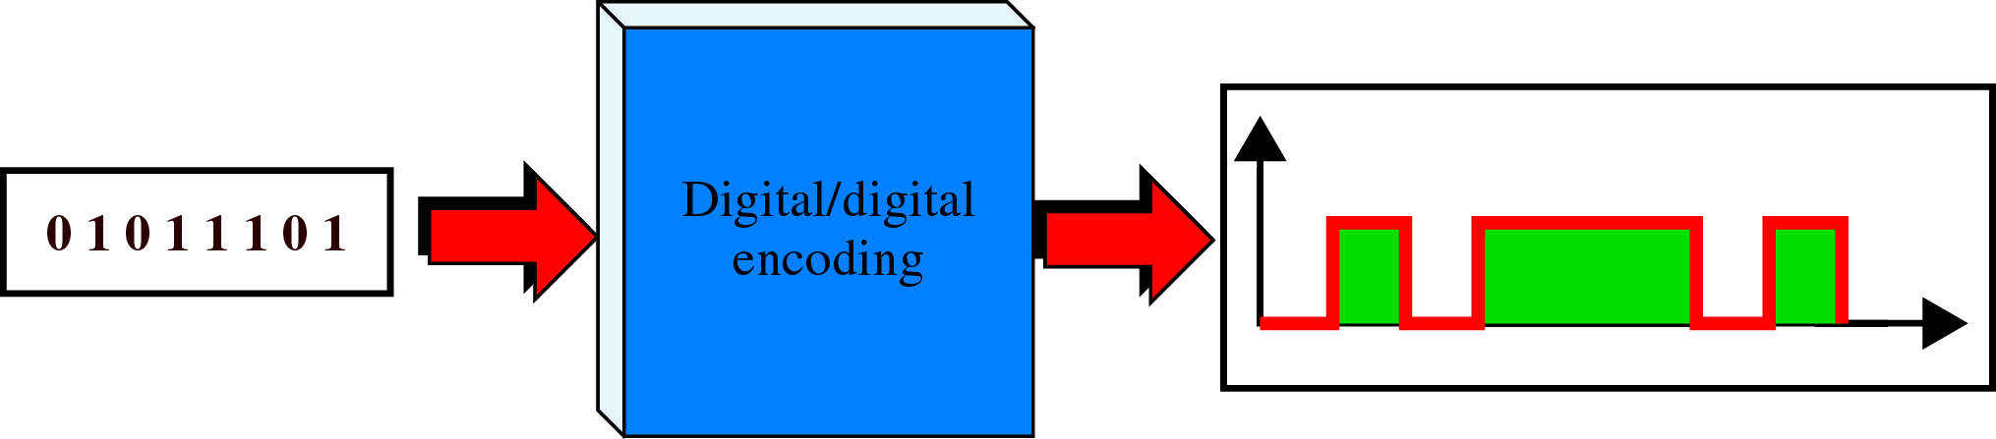
Digital to Digital Conversion
Line Coding

Slide 5
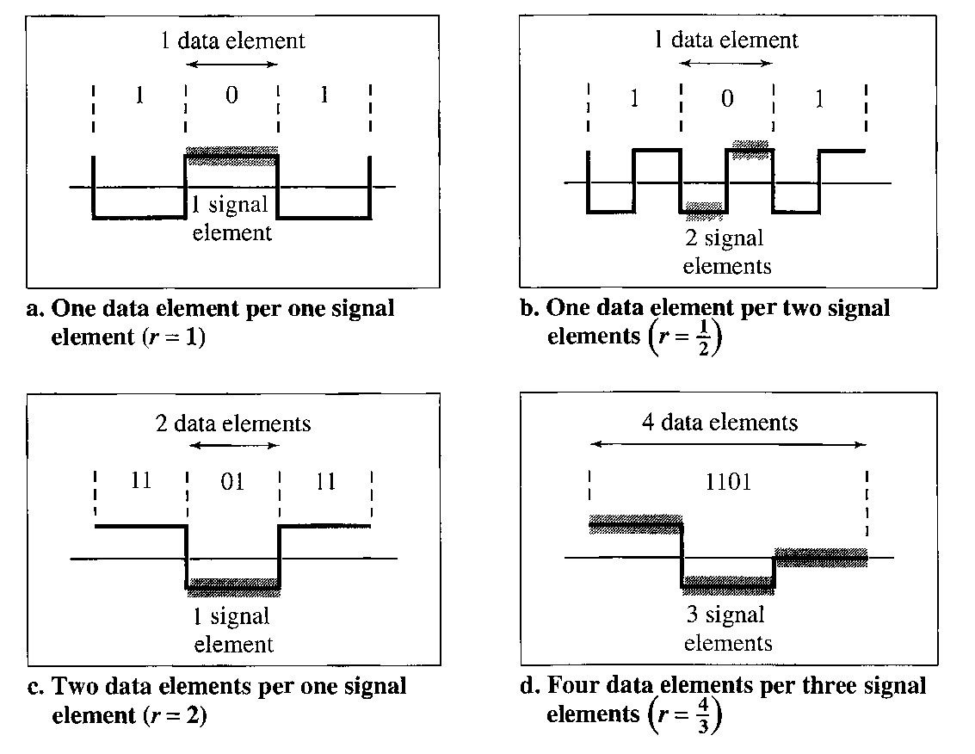
Digital to Digital Conversion
Characteristics of Line Coding
Signal element verses Data element

Slide 6
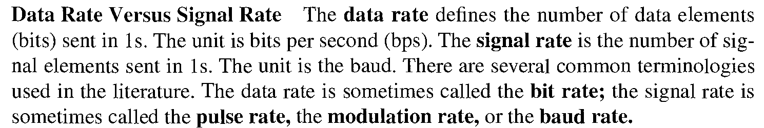
Digital to Digital Conversion
Characteristics of Line Coding
Data Rate verses Signal Rate
Bandwidth

Slide 7
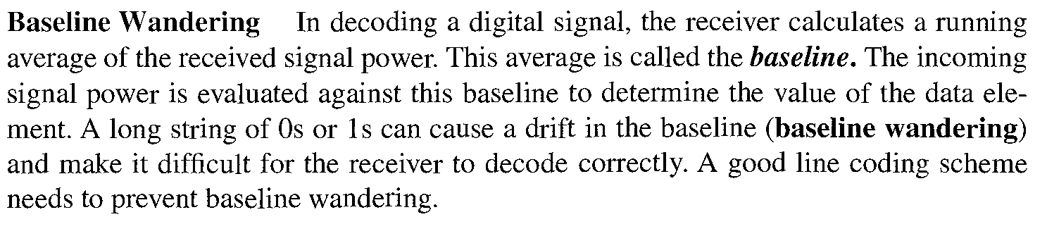
Digital to Digital Conversion
Characteristics of Line Coding
Baseline Wandering

Slide 8
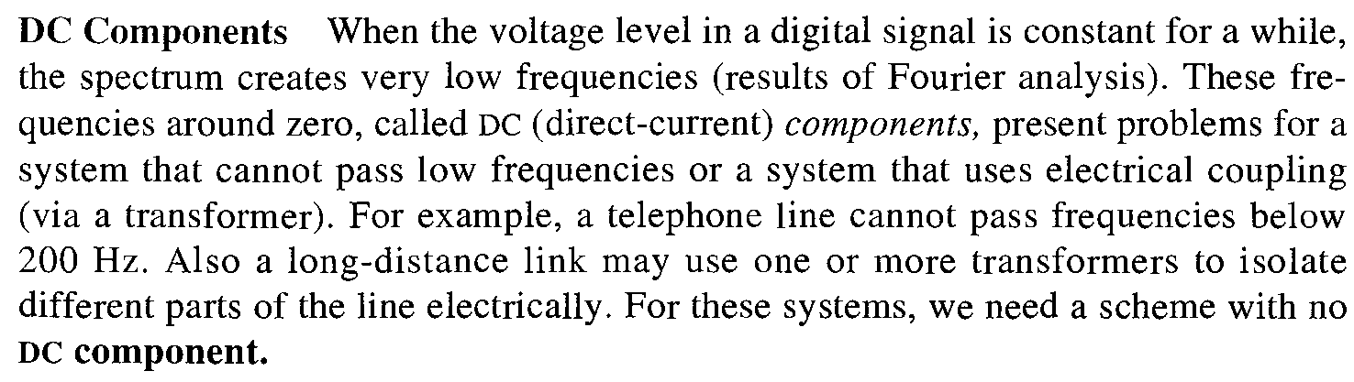
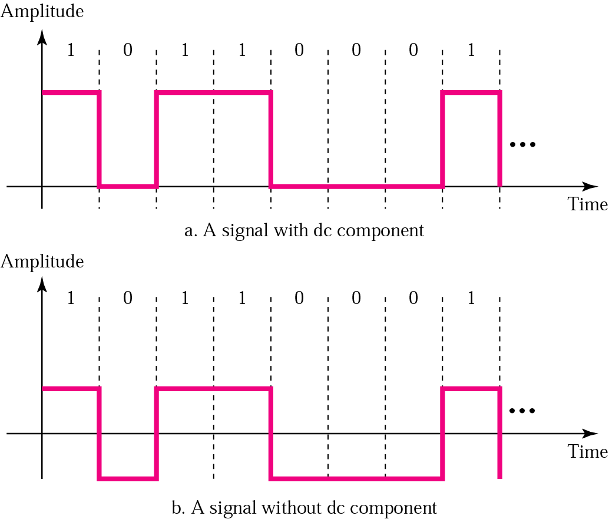
Digital to Digital Conversion
Characteristics of Line Coding
DC Component

Slide 9
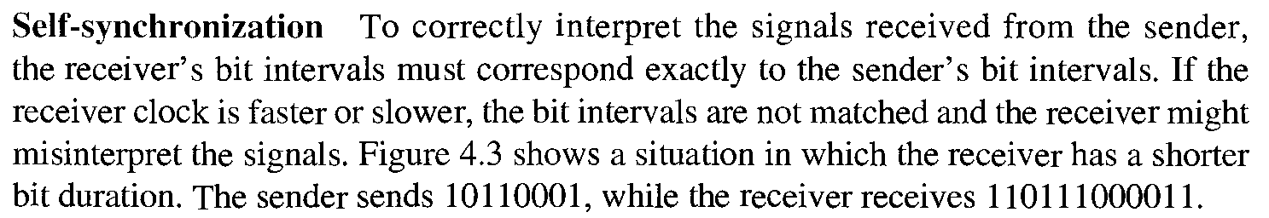
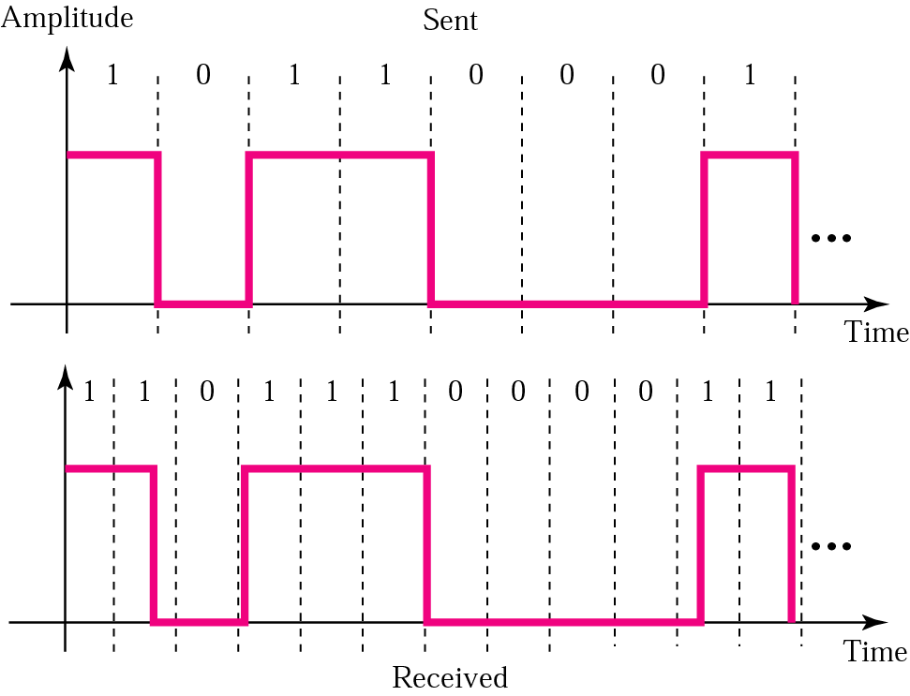
Digital to Digital Conversion
Characteristics of Line Coding
Self Synchronization

Slide 10
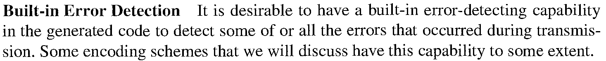
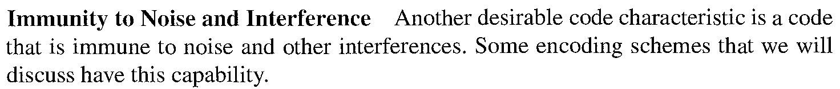
Digital to Digital Conversion
Characteristics of Line Coding
Built in Error Detection
Immunity to Noise Interference

Slide 11
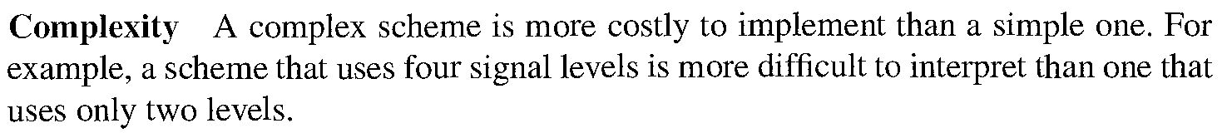
Digital to Digital Conversion
Characteristics of Line Coding
Complexity

Slide 12
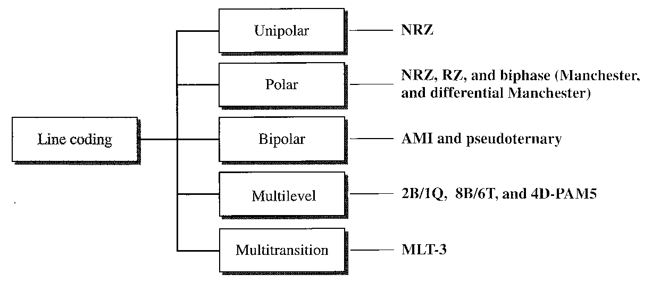
Digital to Digital Conversion
Line Coding Schemes

Slide 13
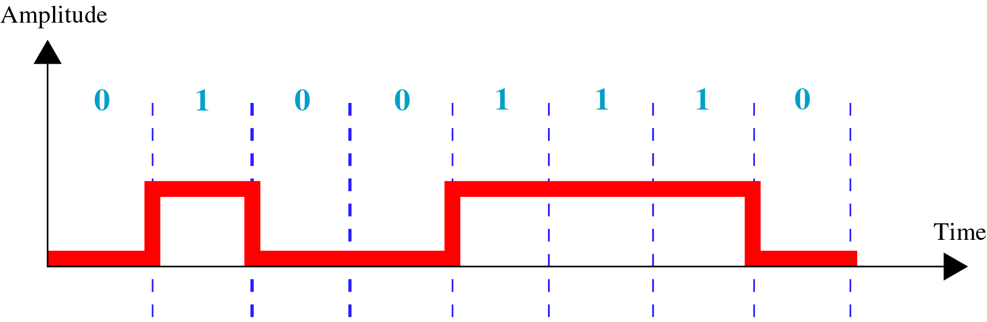
Digital to Digital Conversion
Unipolar Encoding
Unipolar encoding uses only one voltage level.

Slide 14
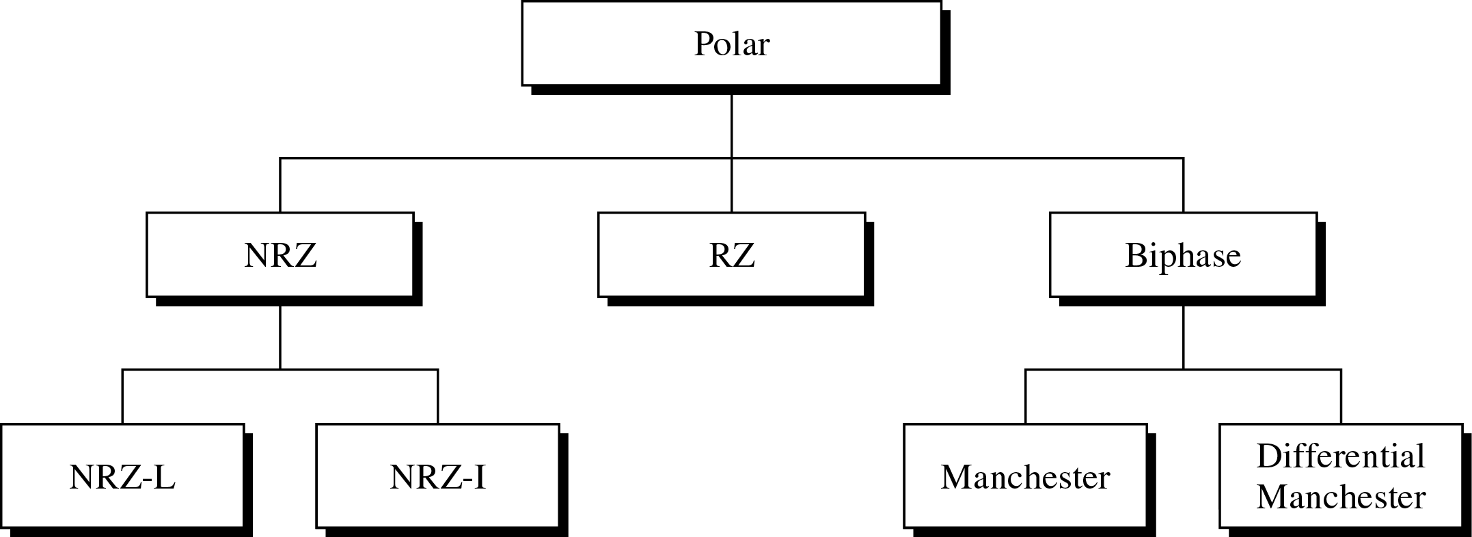
Digital to Digital Conversion
Polar Encoding
Polar encoding uses two voltage levels (positive and negative).

Slide 15
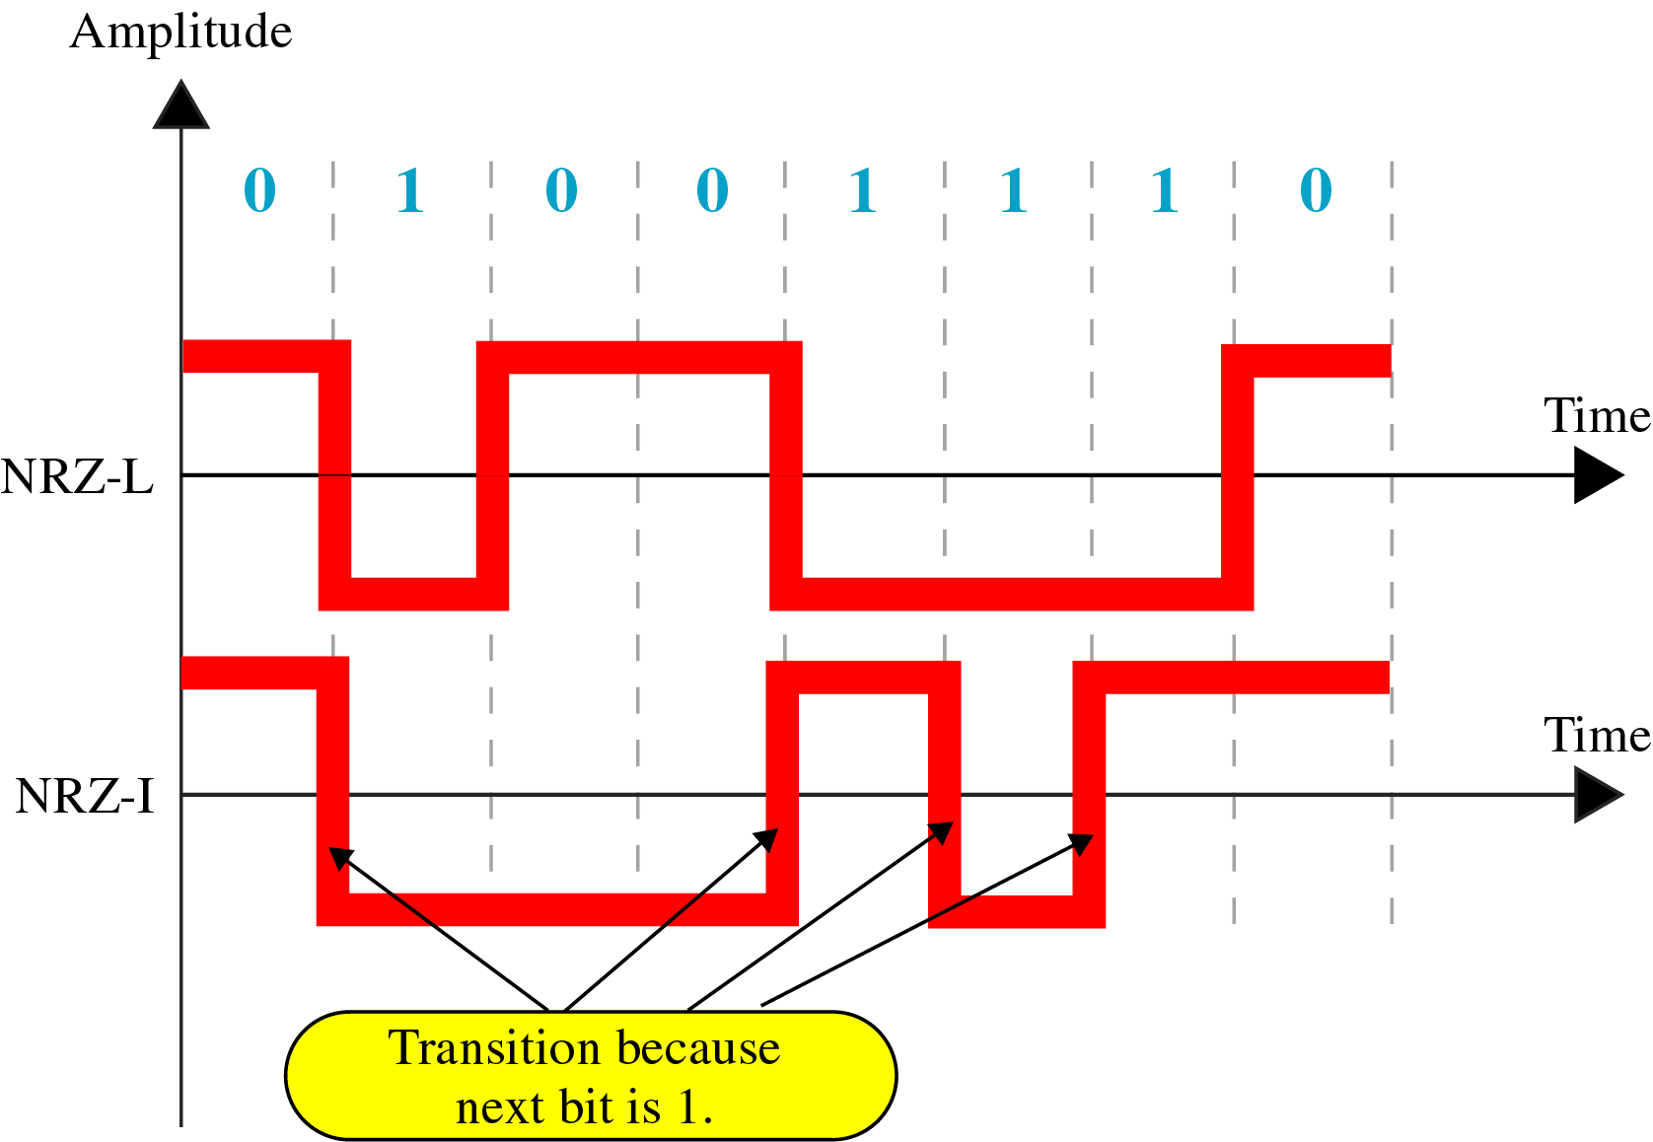
Digital to Digital Conversion
NRZ - Polar Encoding

Slide 16
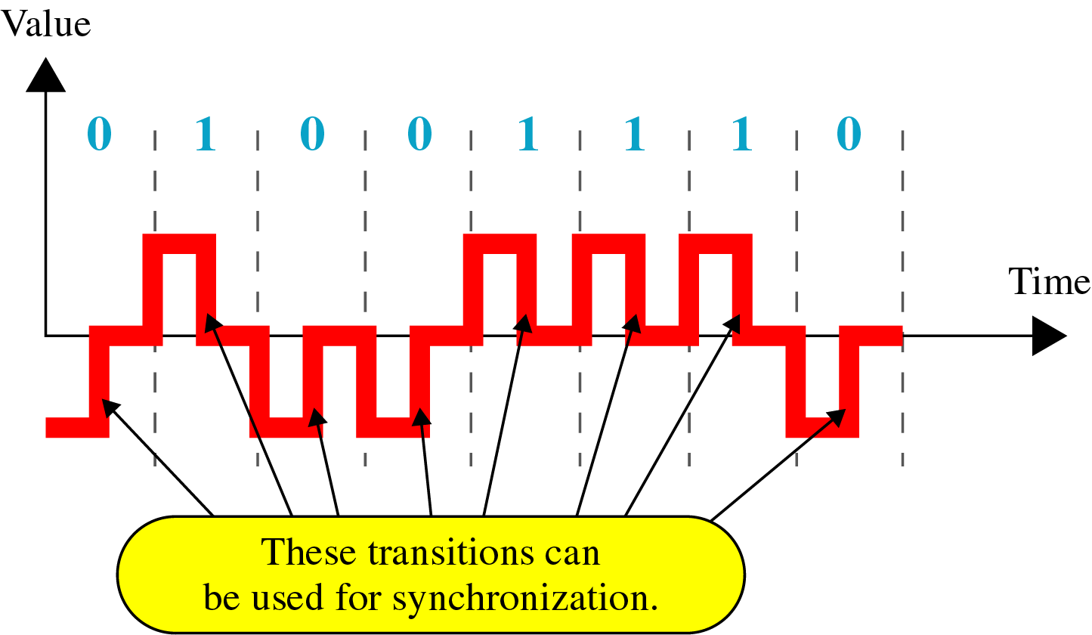
Digital to Digital Conversion
RZ - Polar Encoding

Slide 17
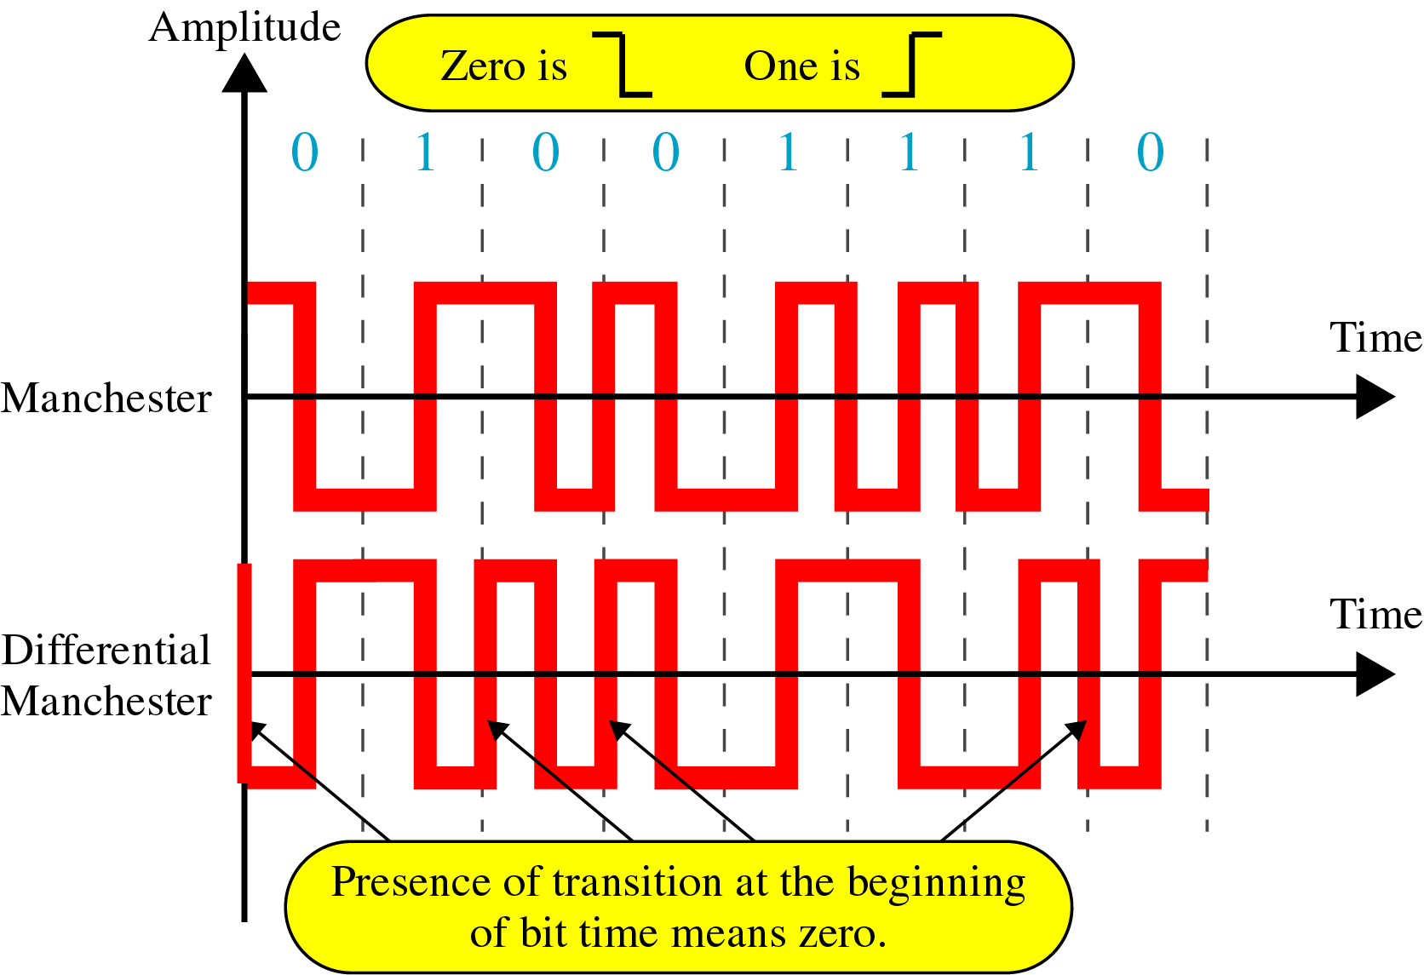
Digital to Digital Conversion
RZ - Polar Encoding

Slide 18
Figure 5-8
Manchester and Diff. Manchester Encoding

Slide 19
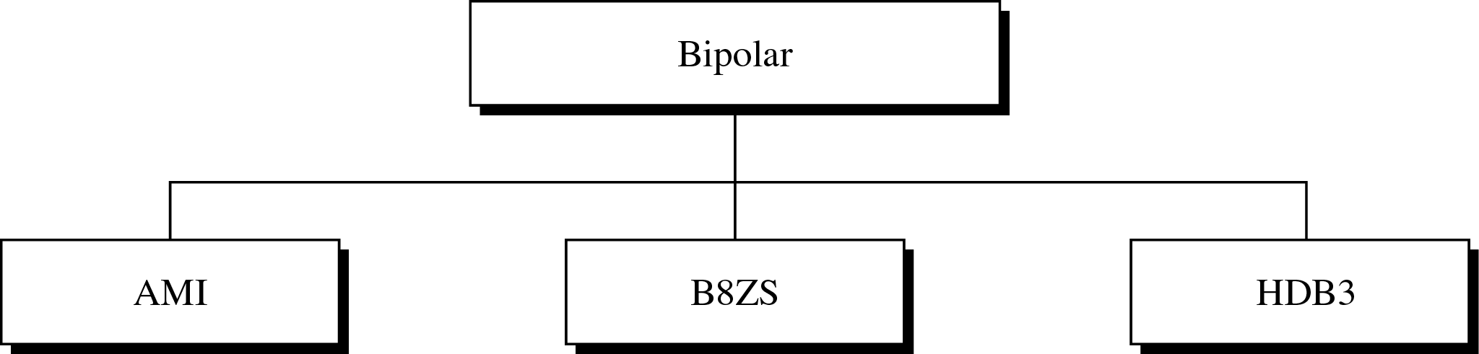
Digital to Digital Conversion
Bipolar Encoding
In bipolar encoding, we use three levels: positive, zero, and negative.

Slide 20
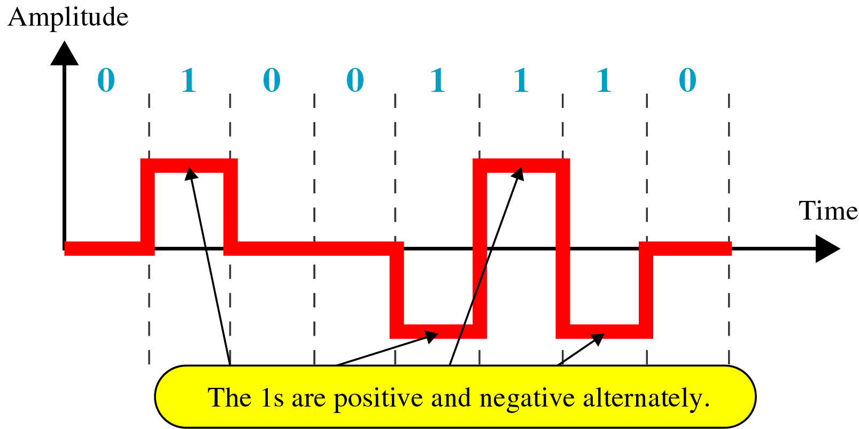
Digital to Digital Conversion
AMI – Bipolar Encoding

Slide 21
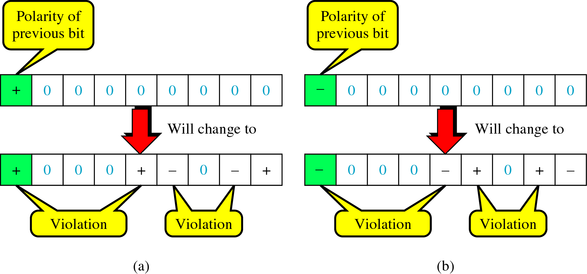
Digital to Digital Conversion
B8ZS – Bipolar Encoding

Slide 22
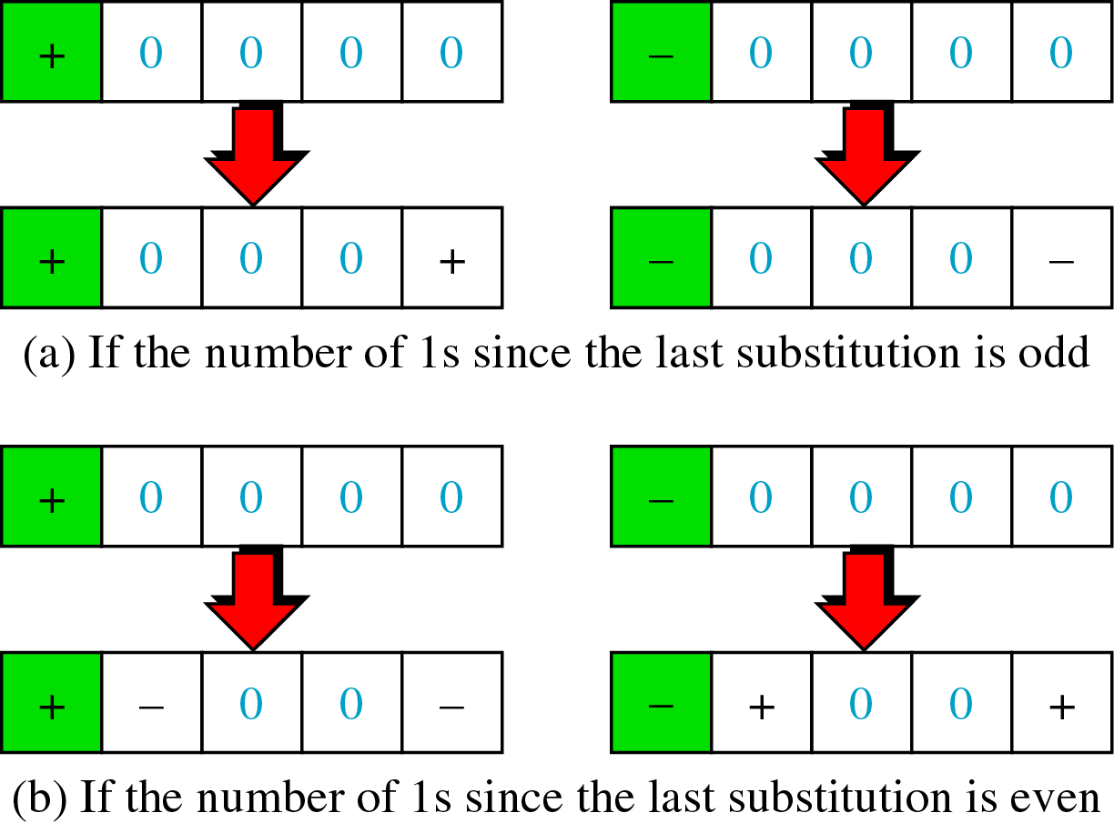
Digital to Digital Conversion
HDB3 – Bipolar Encoding

Slide 23
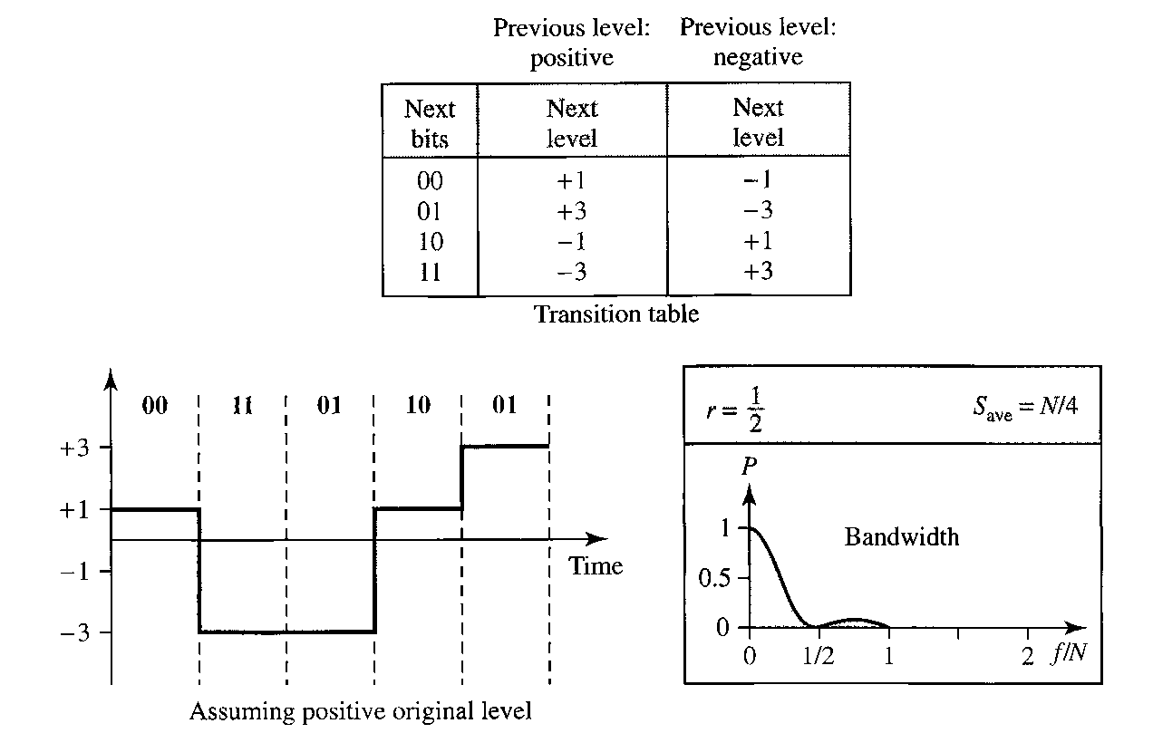
Digital to Digital Conversion
2B1Q – Multi Level Schemes

Slide 24
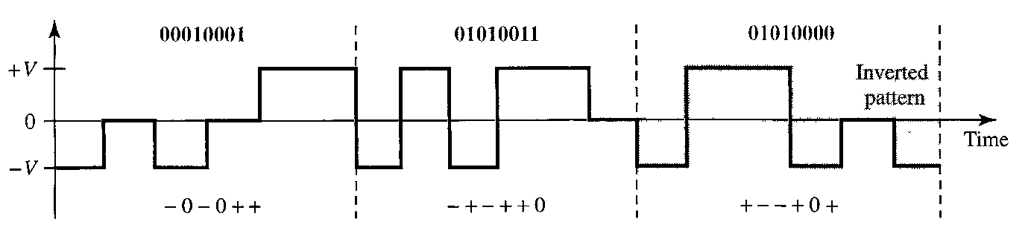
Digital to Digital Conversion
8B6T – Multi Level Schemes

Slide 25
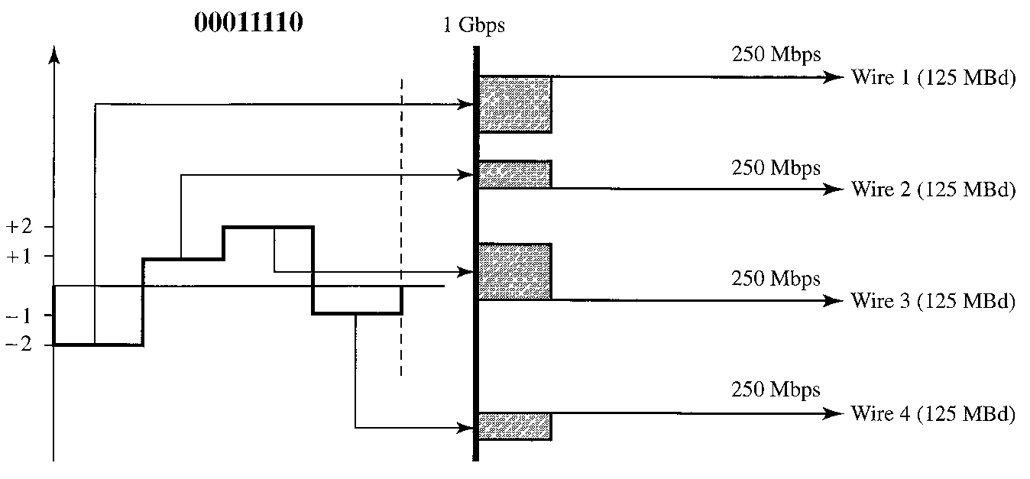
Digital to Digital Conversion
4D-PAM5 – Multi Level Schemes

Slide 26
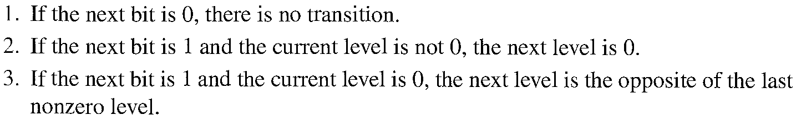
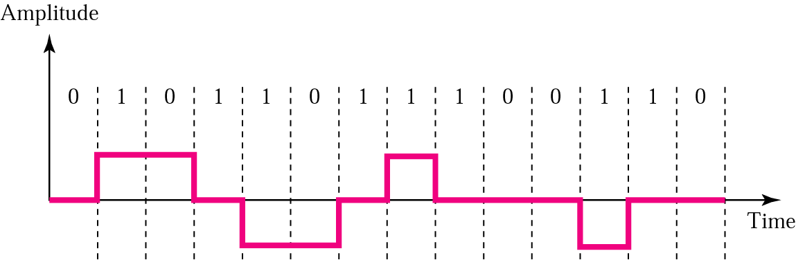
Digital to Digital Conversion
Multiline Transmission – MLT3
Multiline transmission, three level (MLT-3) scheme uses three levels (+V, 0 and –V) and three transition rules to move between the levels

Slide 27
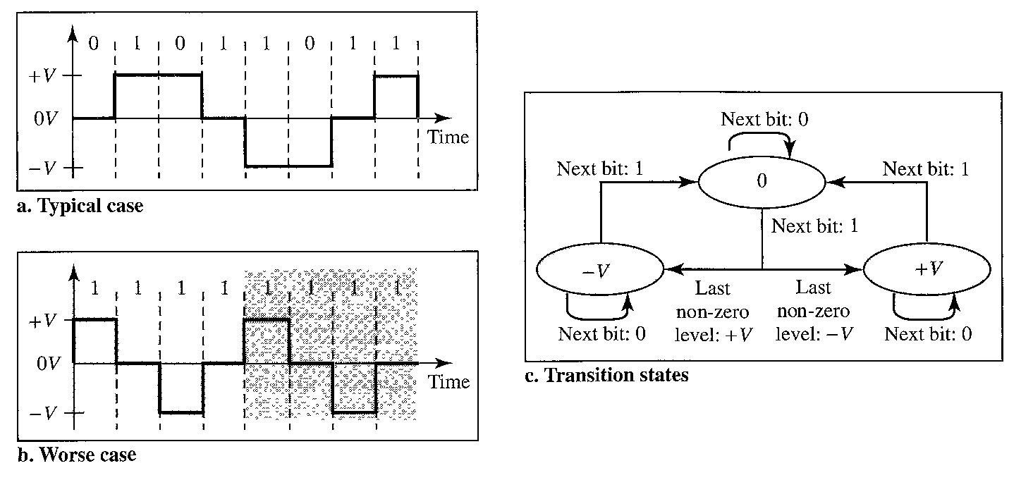
Digital to Digital Conversion
Multiline Transmission – MLT3

Slide 28
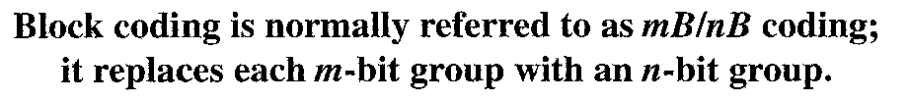
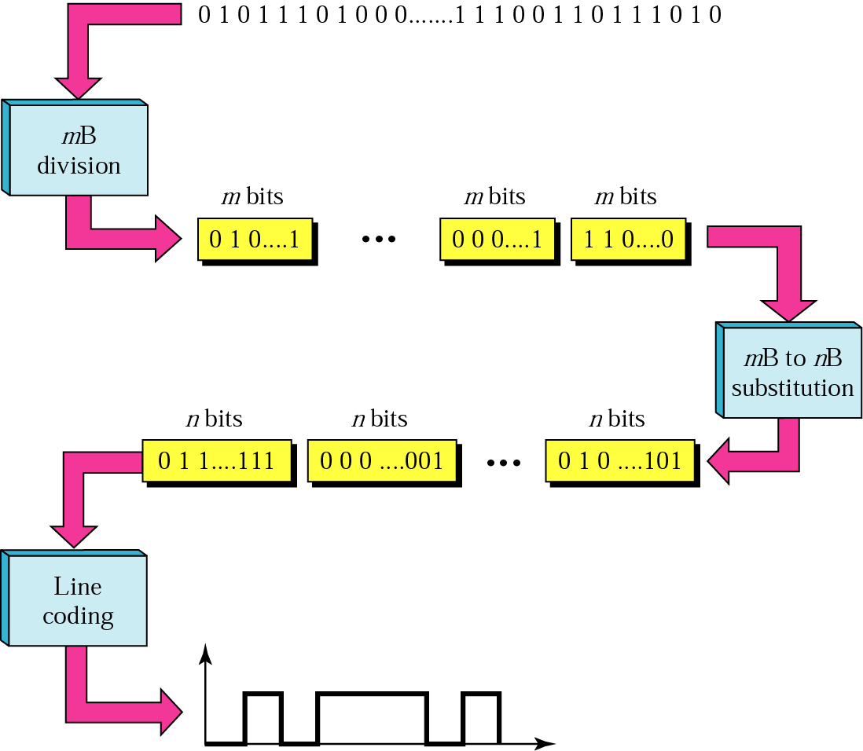
Digital to Digital Conversion
Block Coding

Slide 29
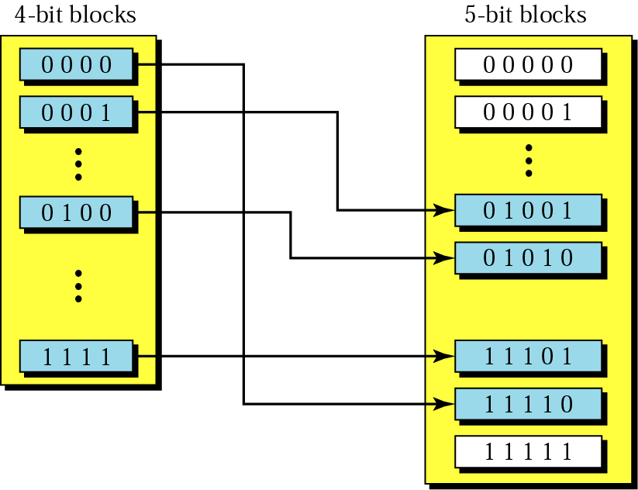
Digital to Digital Conversion
4B/5B – Block Coding

Slide 30
Digital to Digital Conversion
4B/5B – Block Coding
Table 4.1 4B/5B encoding
Data | Code | Data | Code
0000 | 11110 | 1000 | 10010
0001 | 01001 | 1001 | 10011
0010 | 10100 | 1010 | 10110
0011 | 10101 | 1011 | 10111
0100 | 01010 | 1100 | 11010
0101 | 01011 | 1101 | 11011
0110 | 01110 | 1110 | 11100
0111 | 01111 | 1111 | 11101

Slide 31
Digital to Digital Conversion
4B/5B – Block Coding
Table 4.1 4B/5B encoding (Continued)
Data | Code
Q (Quiet) | 00000
I (Idle) | 11111
H (Halt) | 00100
J (start delimiter) | 11000
K (start delimiter) | 10001
T (end delimiter) | 01101
S (Set) | 11001
R (Reset) | 00111

Slide 32
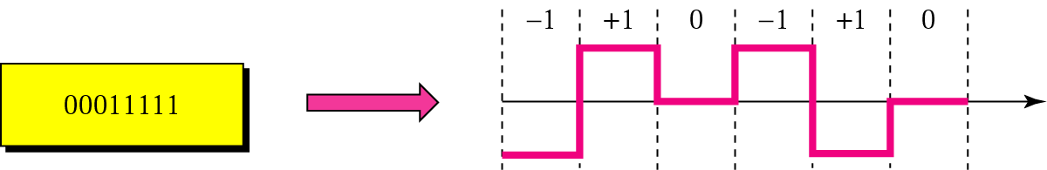
Digital to Digital Conversion
8B/10B – Block Coding

Slide 33
Analog to Digital Conversion

Slide 34
Analog to Digital Conversion
PAM

Slide 35
Analog to Digital Conversion
Quantized PAM

Slide 36
Analog to Digital Conversion
PAM
Pulse amplitude modulation has some applications, but it is not used by itself in data communication. However, it is the first step in another very popular conversion method called pulse code modulation.

Slide 37
Analog to Digital Conversion
PCM
The most common technique to change an analog signal to digital data is called Pulse Code Modulation (PCM).
PCM encoder has three processes:-
The Analog Signal is sampled
The sampled signal is quantized
The quantized values are encoded as streams of bits

Slide 38
Analog to Digital Conversion
Analog to PCM

Slide 39
Analog to Digital Conversion
Analog to PCM

Slide 40
Analog to Digital Conversion
Analog to PCM

Slide 41
Analog to Digital Conversion
Analog to PCM

Slide 42
Analog to Digital Conversion
PCM
Source of continuous-time (i.e., analog) message signal
Low pass
Filter
Sampler
Quantizer
Encoder
PCM Signal
Analog-to-Digital Converter
Low Pass Filter
Confining the frequency content of the message signal
Sampling
To ensure perfect reconstruction of message signal at the receiver, the sampling rate must exceed twice the highest frequency component of the message signal (Sampling Theorem)
Quantization
Converting of analog samples to a set of discrete amplitudes
Encoding
Translating the discrete set of samples in a form suitable for digital transmission

Slide 43
Analog to Digital Conversion
Quantization
Quantization Levels
Quantization Error
Uniform and Non uniform Quantization Error
Delta Modulation
Adoptive DM
Error Rate

Slide 44
Uniform Quantizers
Representation levels are uniformly spaced
4
4
2
2
-4
-2
0
2
4
-4
-2
0
2
4
-2
-2
-4
-4
Mid-Tread Uniform Quantizer
Mid-Rise Uniform Quantizer

Slide 45
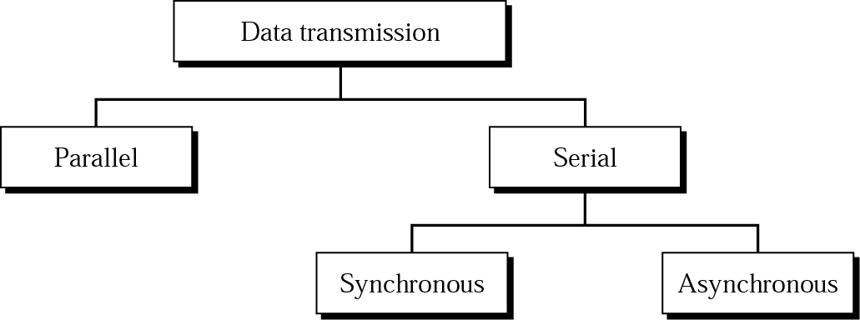
Transmission Modes

Slide 46
Transmission Modes
Parallel Transmission

Slide 47
Transmission Modes
Serial Transmission

Slide 48
Transmission Modes
Asynchronous Transmission

Slide 49
Transmission Modes
Synchronous Transmission

